Slide 1
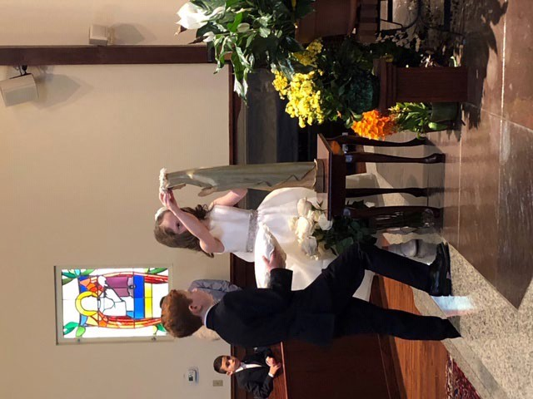
From: To: Subject: Date:
joancorso@gmail.com jcboutross sjsmrcc.com May crowning
Thursday, May 16, 2019 10:51:11 AM
Sent from my iPhone

